Slide 1
Building Faculty Web Pages with Expressions Web 3
Presented by Sarah Huibregtse
sarah.huibregtse@mstc.edu

Slide 2
Preparing to Build your Web Site
Gather materials
Syllabus for all courses
Additional course handouts
URLs (web addresses) to online resources
Convert Word documents to PDFs
PDF is the preferred option for viewing and sharing documents
More secure
Easily accessible
Compact size
Images
Edit and/or crop
Reduce file size, if possible
Thumbnails - 100kb or less (preview version)
Enlarged - 1mb or less
Photo Editing software is available in the EDC

Slide 3
Sample MSTC Faculty Web Sites
Sites that use the current template
Cindy Sebastiani
Sarah Huibregtse
EDC Web Site Training Intranet Site
Sites that use an older version of the template
Melissa Nash
Anne Dyken
Kathy Trachte
Sandi Taucher (single page)

Slide 4
Before We Begin
Avoid the following Web Design mistakes…

Slide 5
MSTC Faculty Web Page Guidelines
Use Mid-State Technical College and/or MSTC when referencing the college
Fonts and Font Sizes (set by style sheet)
All fonts are defaulted to "Verdana, Arial, and Helvetica" in that order
Titles/Headings - default size is 16 pixels
Text - default size is 11 pixels
Images File Sizes
Thumbnails - 100kb or less (small image)
Enlarged - 1mb or less
Student Pictures
Verify that students have signed a Photo Release – Permission to Publish form (found on the Intranet)
Audio Clips
If included, provide the user with an option to play it
Please do not have it start automatically
Verify copyright requirements for any picture and/or audio files

Slide 6
Good & Bad Web Design

Slide 7
Standard Web Page Design Tips
Use web safe colors
Ensure foreground colors contrast well with background colors
When specifying fonts, always include a generic, font type in case the user computer doesn’t have your font
Limit to 2-3 fonts
Limit to 3-4 font sizes
Use GIFs and JPGs files appropriately
Provide alternate text for image maps (accessibility requirement)
This is the text that appears when you hover over the image
Don’t use too many images
Reuse images within a web site
Give pages within a web site a consistent appearance (use template)
Include width and height attributes for all images
Use thumbnails to allow users to preview large images
View your page in a browser with images turned off
Avoid large amounts of unnecessary white space except on the outside margins
from Creating Web Pages with HTML and XHTML, by Patrick Carey, pages 159-160, Course Technology, 2006

Slide 8
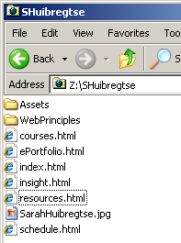
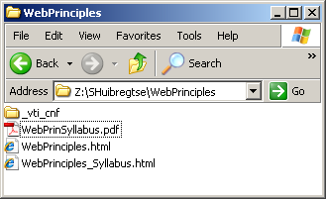
Z: Drive Folder & File Organization
Keep files organized
Create a folder for each course
Avoid spaces or symbols in file names
Underscores are commonly used
Use PDFs to share documents, unless it needs to be edited
Remove unused and/or unlinked files
Stored files are still accessible and searchable via the Internet

Slide 9
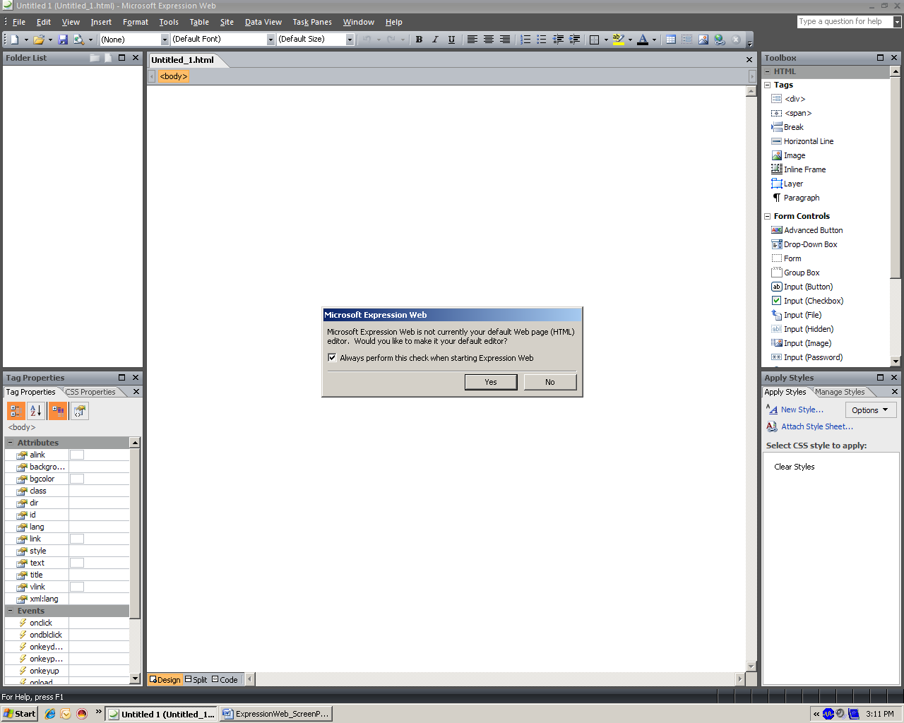
Starting Microsoft Expression Web
When you open Microsoft Expression Web for the first time your screen will look similar to this.
We will personalize this next.

Slide 10
Starting Microsoft Expression Web
The first time you open Expression Web you will receive two pop-up windows
Uncheck the box for the first one and click No
This prevents this pop-up from appearing every time you open Expression Web
You may or may not receive this pop-up.

Slide 11
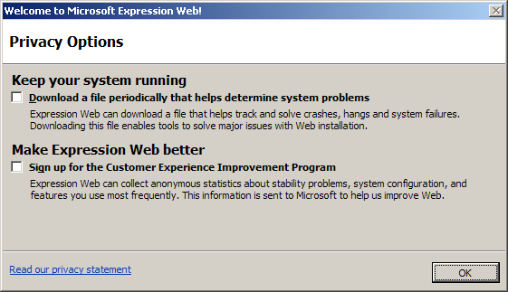
Starting Microsoft Expression Web
Click OK for the second pop-up
You may or may not receive this pop-up.

Slide 12
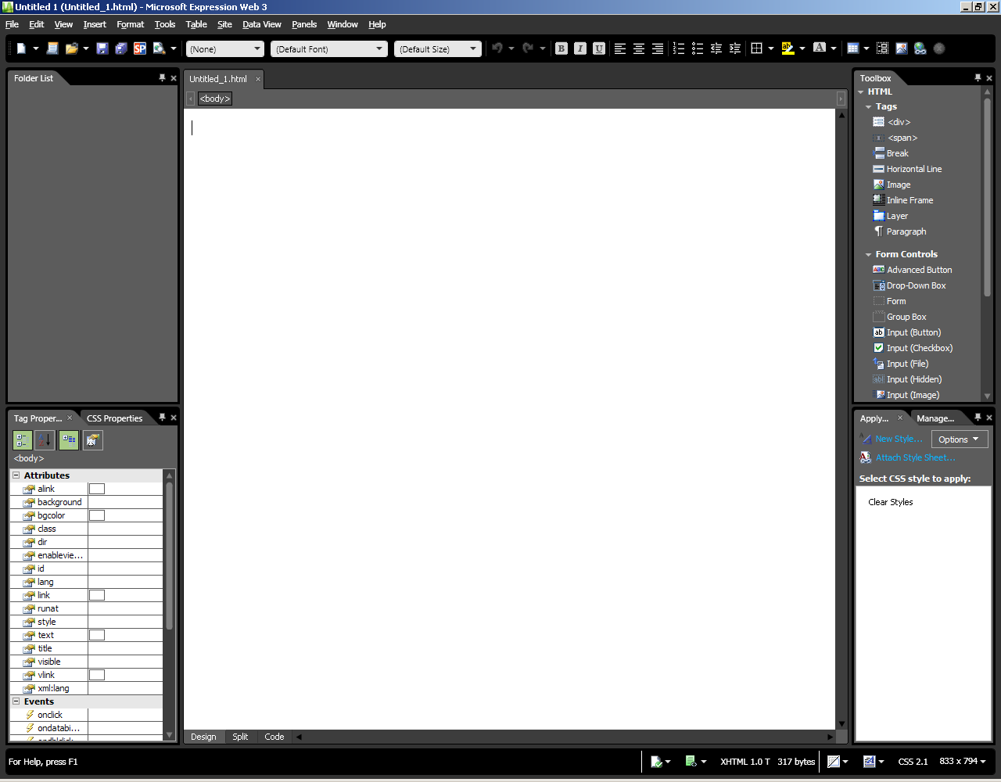
Click the to close these windows to give yourself more screen space.
You can always open them again, if needed.

Slide 13
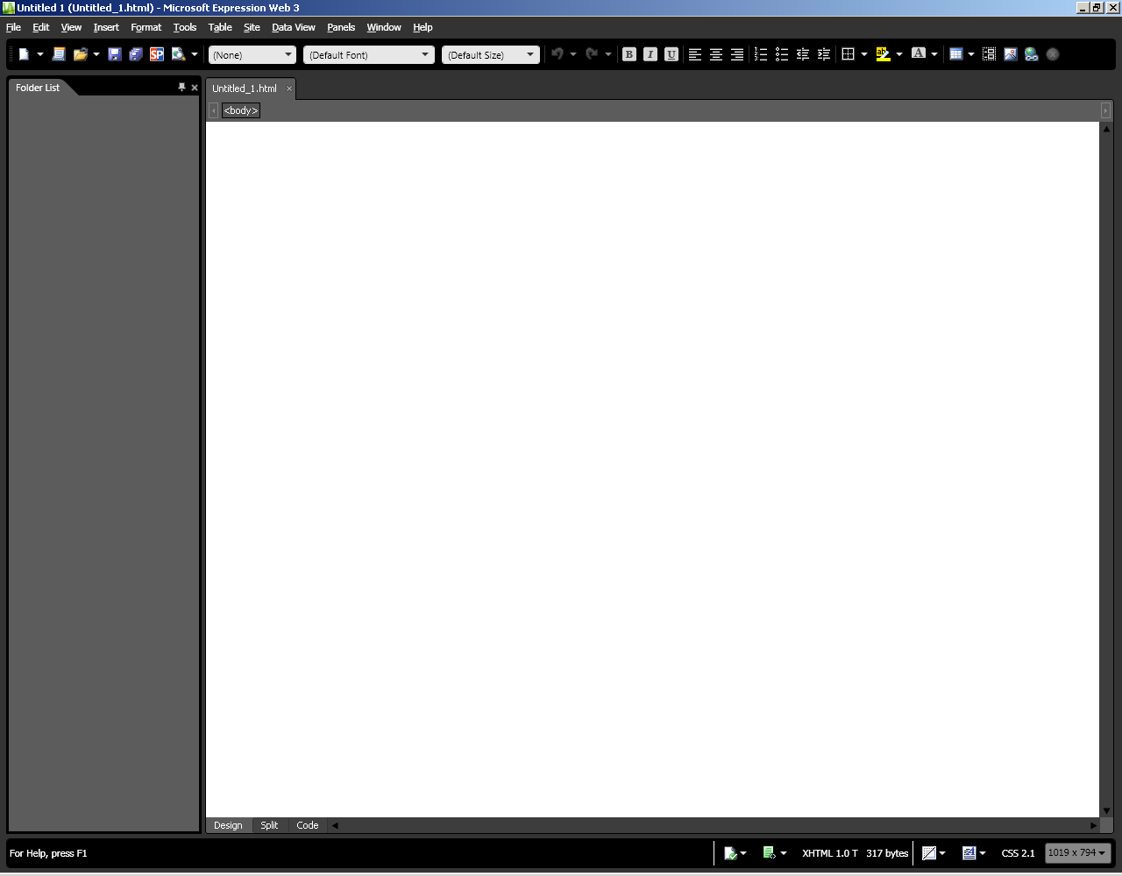
We are ready to unpack our template package!!

Slide 14
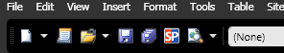
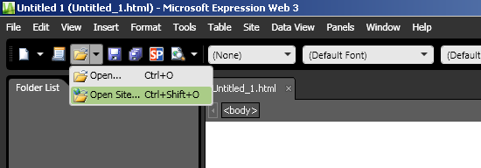
Open Your Site (Z: Drive)
Click on the dropdown arrow next to the open folder
select Open Site…

Slide 15
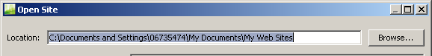
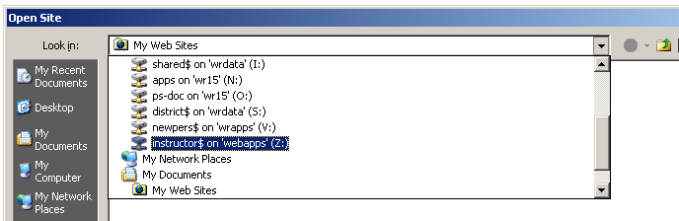
Open Your Site (Z: Drive)
Click the Browse… button
From the Look in dropdown select “instructor$ on ‘webapps’ (Z:)”

Slide 16
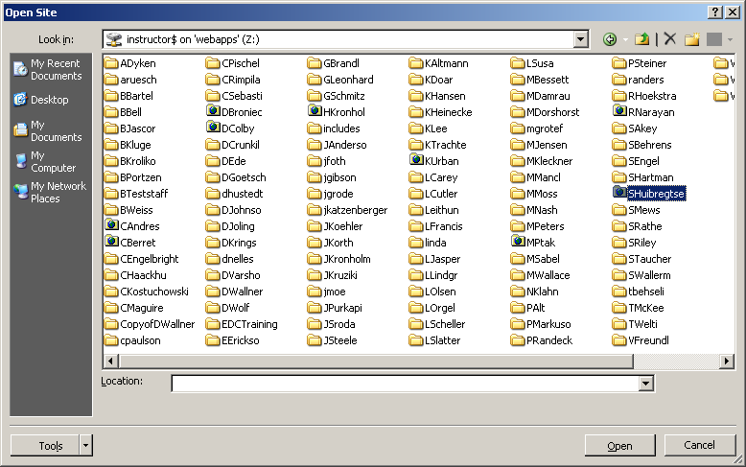
Open Your Site (Z: Drive)
Single click your Web Site folder
Click Open

Slide 17
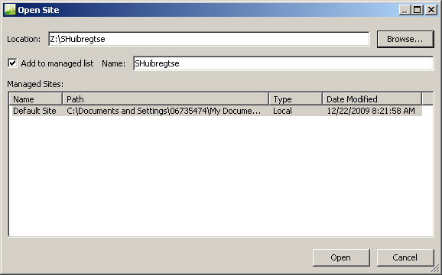
Open Your Site (Z: Drive)
Your Z: Drive is now the Site Location
By default the “Add to managed list” will be checked
Change the Name of your site for future reference, if necessary
This option makes it quick and easy to access your site the next time you open Expression Web
Click Open

Slide 18
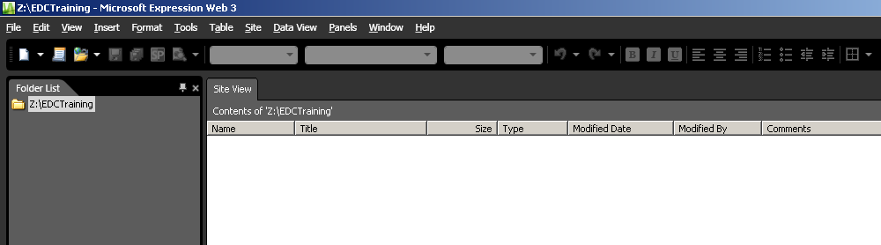
Open Your Site (Z: Drive)
Your Web Folder will now display in the following locations:
Folder List
Site View Window
Note that at this point your folder will most likely be empty!

Slide 19
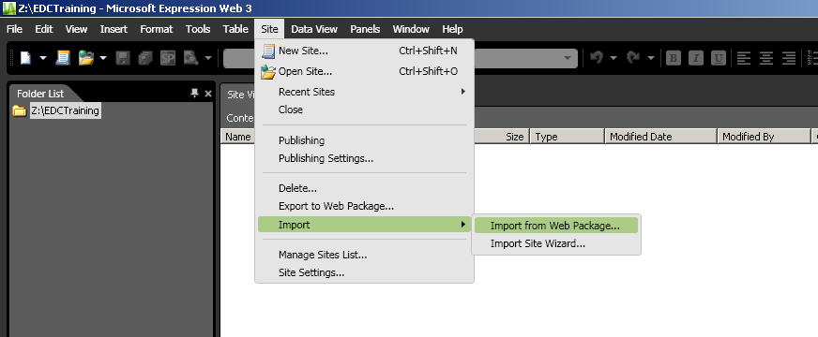
Open Faculty Web Template Package
All the necessary files for you to begin your MSTC Faculty Web Site have been packaged for you. Let us unpack them…
Click Site on the menu bar
Hover over Import
Select Import from Web Package…

Slide 20
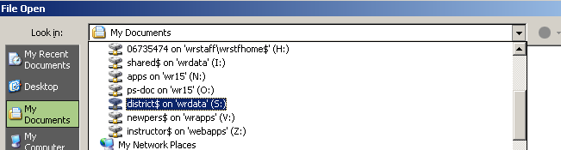
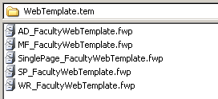
Open Faculty Web Template Package
Select the S: Drive from the dropdown
Navigate to the WebTemplate.tem folder

Slide 21
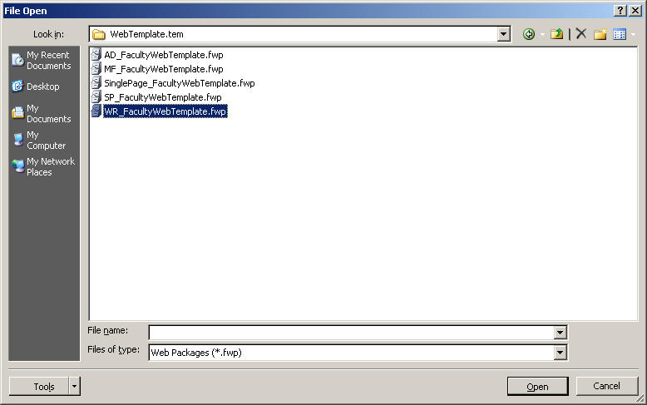
Open Faculty Web Template Package
Select the package (**_FacultyWebTemplate.fwp) file for your campus location
Click Open
The only difference in these templates is the campus name and address in the footer

Slide 22
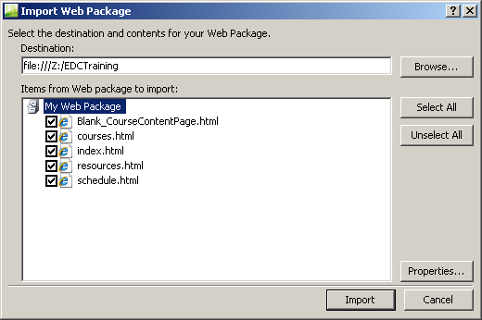
Open Faculty Web Template Package
The Import Web Package pop-up will appear
Click Import

Slide 23
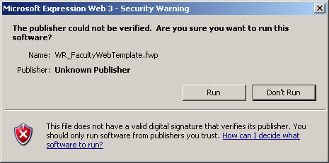
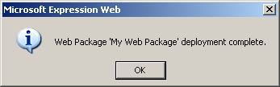
Open Faculty Web Template Package
Click Run for the Security Warning
When the package is ready click OK

Slide 24
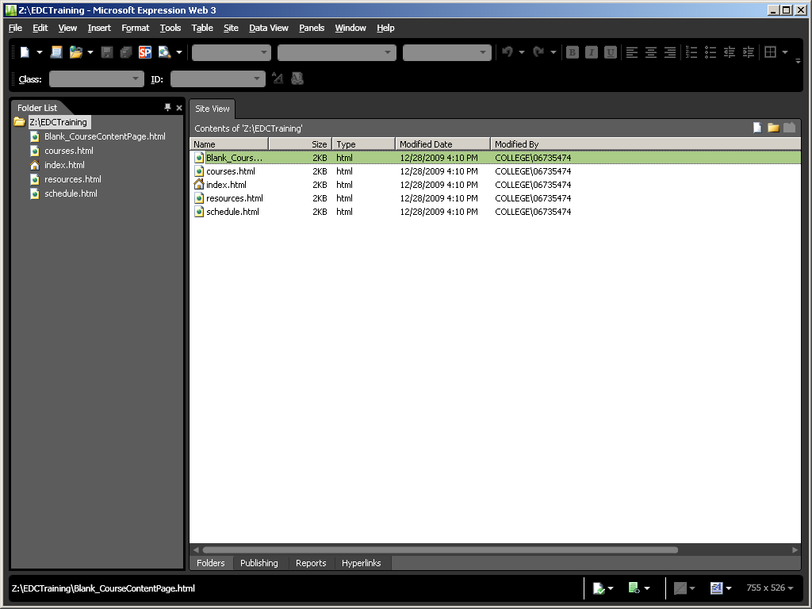
We are ready to begin personalizing your faculty web site!!!

Slide 25
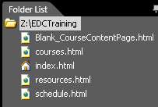
Faculty Web Site Files
The Faculty Web Template package includes the following files:
index.html
Home/default web page
schedule.html
A table has been added for you to use or you can copy and paste your schedule from another document
courses.html
Great place to list the courses you teach and provide links to your syllabus, course information, PDF and Word files, web resources, etc.
resources.html
Place for you to provide additional resources and/or links
Blank_CourseContentPage.html
This page is provided for you to create separate pages for courses
Rename the file to match your course title and/or number

Slide 26
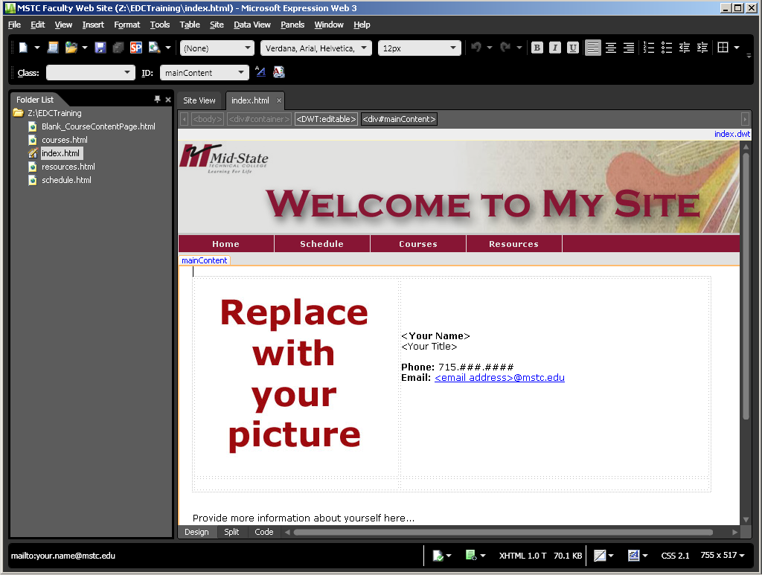
Double click the index.html file in the folder list.
This is the home page to your web site. It is the file that will be linked from the “Faculty & Staff Home Page” of MSTC’s web site.

Slide 27
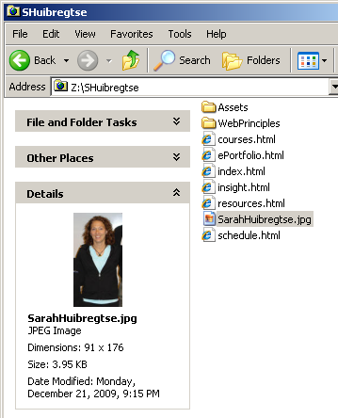
Replace the Picture
Find the dimensions of your new image
Write these down for future reference
Mine is 91 x 176 (width x height)
Verify the size of your image file
Mine is 3.95 KB (located below the dimensions)
We have software available in the EDC to help reduce the size
MSTC Image Size Guidelines
Thumbnails - 100kb or less
Enlarged - 1mb or less

Slide 28
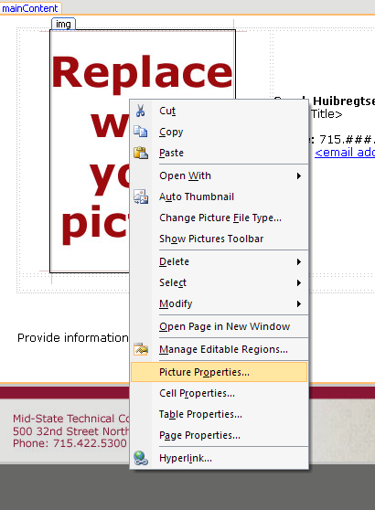
Replace the Picture
Right click the image
Select Picture Properties…
To add a new picture
Click Insert the menu bar
Select Picture
Click From File…

Slide 29
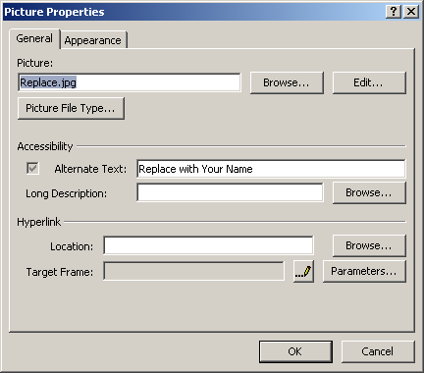
Replace the Picture
Browse to your picture on the Z: Drive
Add Alternate Text
this is the text that displays when you hover over the image
Click OK
Click the resizing handles to adjust the display size of your picture as needed

Slide 30
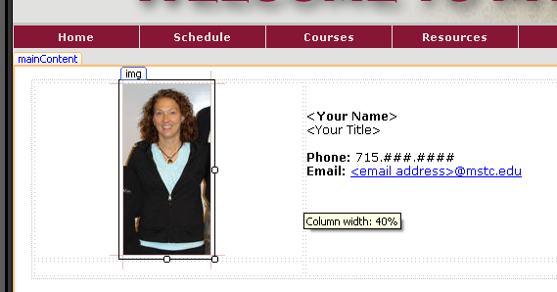
Adjust the Column Width
Drag the dotted line to adjust the column width to better align your picture and text

Slide 31

Select text and replace with your name, title, and contact information.
You may wish to include office hours and location.

Slide 32
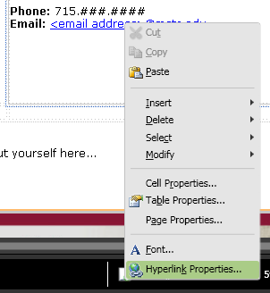
Update/Edit Email Hyperlink
Right click the email address
Select Hyperlink Properties…

Slide 33
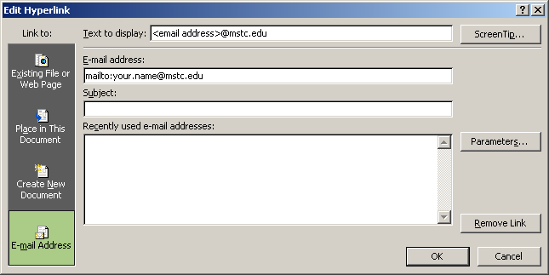
Update/Edit email Hyperlink
In the “Text to display” field, replace <email address> with the first half of your email address (your name)
In the “E-mail address” field replace ONLY your.name with your first and last name
Example: mailto:sarah.huibregtse@mstc.edu
Include a default “subject” if you’d like
Click OK once you’ve updated all the fields
Optional Default Subject

Slide 34
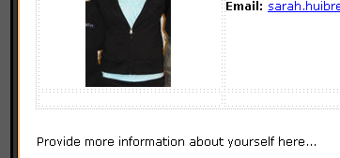
Add “About Me” Information
You may wish to include information about your background and experience below
Common pieces of information included
Education
Teaching and/or work experience
Courses taught
Certifications
Professional Interests
Favorite quotes
Information about family, hobbies, interests, etc.
be careful about how much personal information you share
Try to make content general enough, so you aren’t required to update it regularly

Slide 35
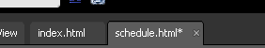
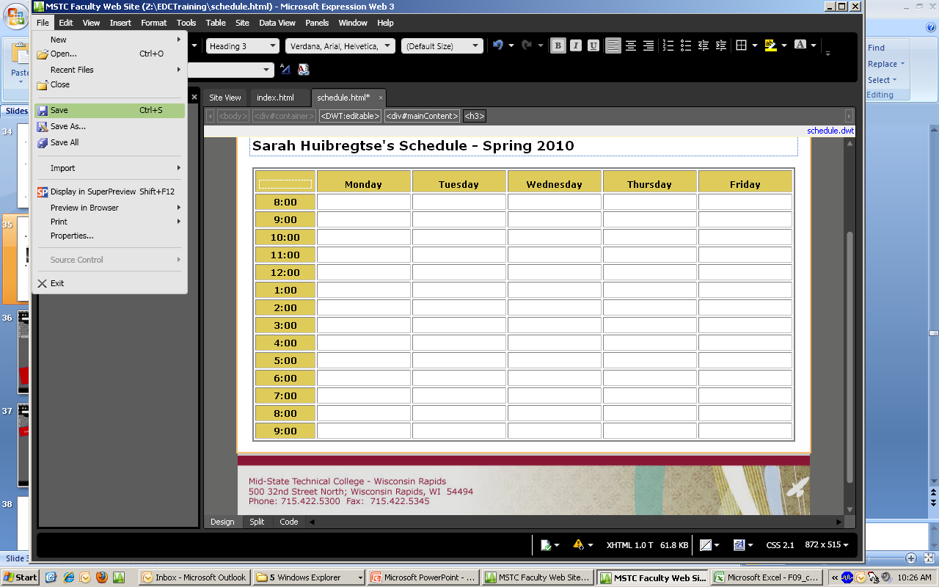
Don’t Forget to SAVE Often!!!
The asterisk lets you know that you haven’t saved your web page
To save do ONE of the following
Click the Save icon
Press CTRL + the letter “S”
Click the Save All icon
Click File on the menu bar and select
Save
Save As…
or Save All

Slide 36
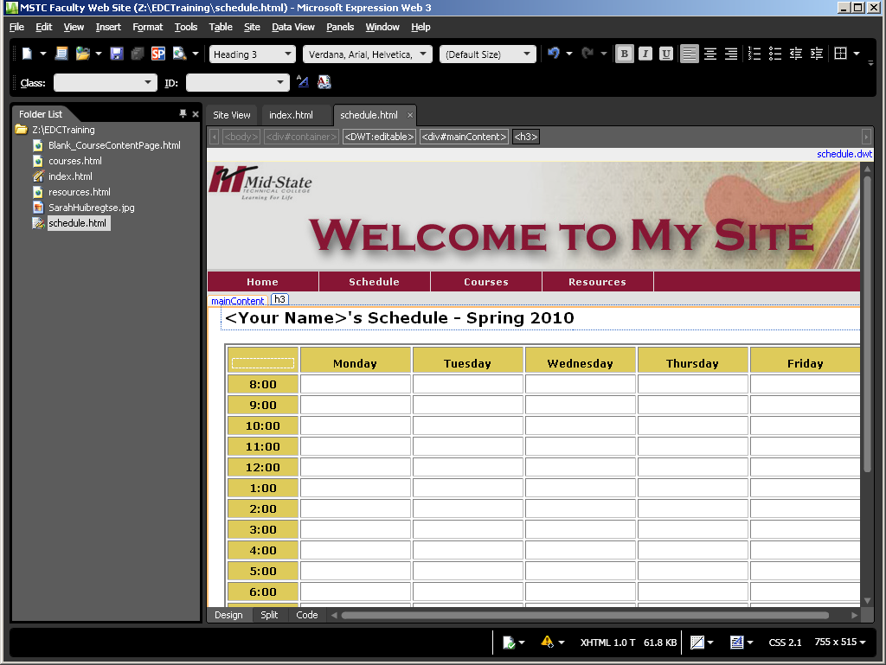
Next, we’ll update the Schedule Page…

Slide 37
Update your name and semester information

Slide 38
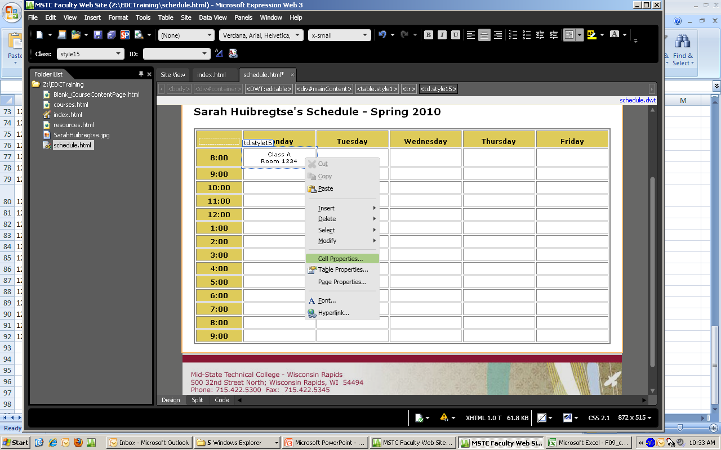
Adding Your Schedule
The table features of Expression Web works similar to those in Microsoft Word
Type your text in a field
Right click in the cell and select Cell Properties…

Slide 39
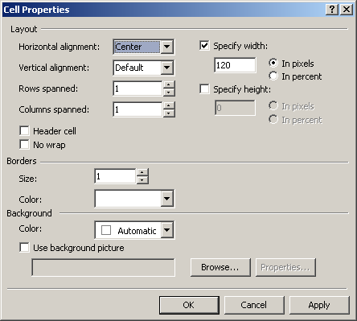
Adding Your Schedule
Adjust the properties as needed. Common changes include
Horizontal alignment
Vertical alignment
No wrap
Background Color (see next slides)

Slide 40
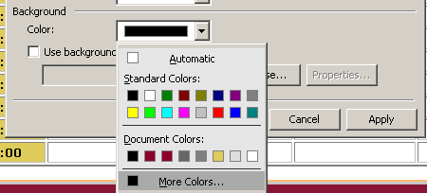
Adding Your Schedule
To change the Background color of a cell
Right click the cell and select Cell Properties…
Click the dropdown under Background Color and select More Colors…

Slide 41
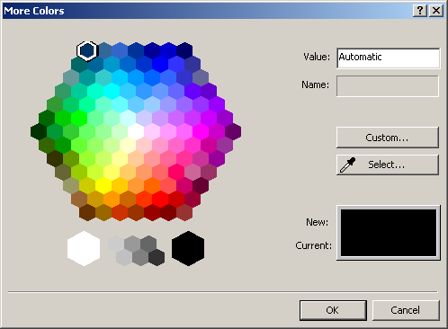
Adding Your Schedule
Select an available color
Click OK
OR….

Slide 42
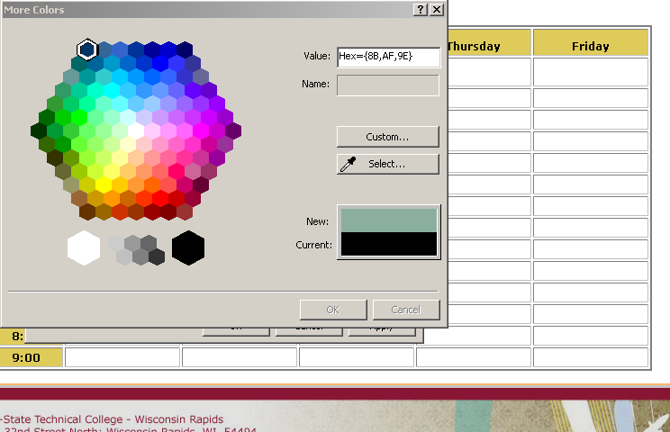
Adding Your Schedule
Click the Select button
Use available images to select a new color with the color picker (eye dropper)

Slide 43
Have you SAVED lately?
The asterisk lets you know that you haven’t saved your web page
To save do ONE of the following
Click the Save icon
Press CTRL + the letter “S”
Click the Save All icon
Click File on the menu bar and select
Save
Save As…
or Save All

Slide 44
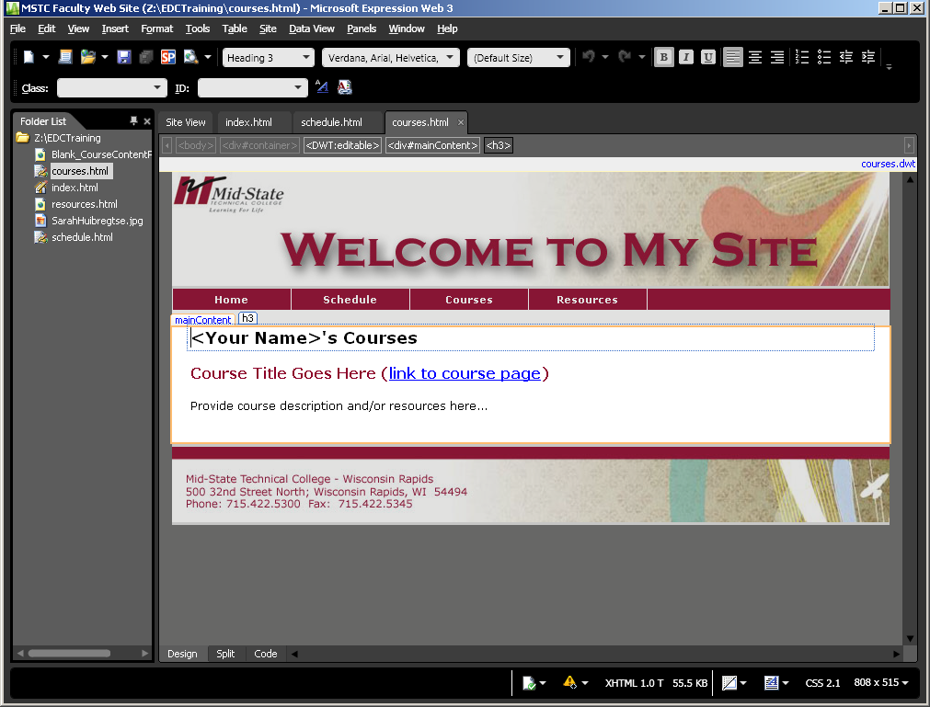
For your Courses page you will need to follow the same steps that we have for our other pages.

Slide 45
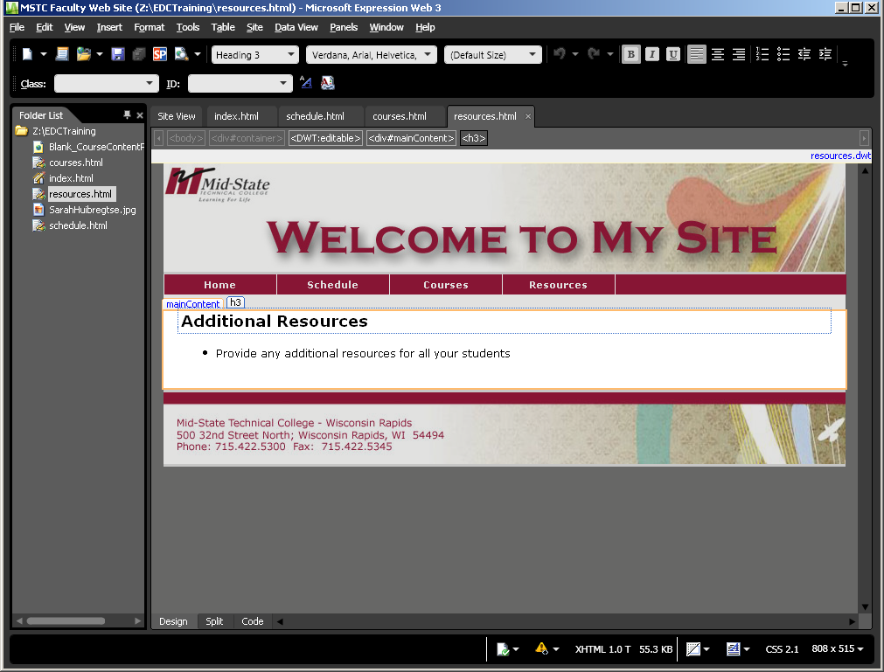
This page is for any additional resources that you’d like to make available to your students.

Slide 46
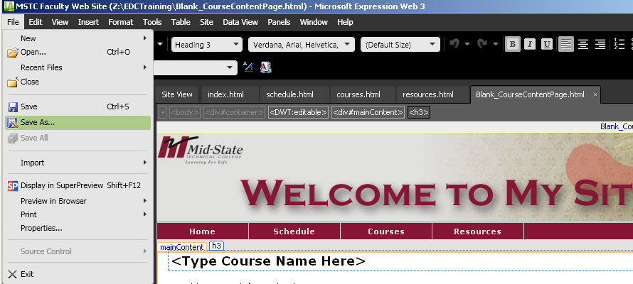
Creating Course Web Pages
Click File and select Save As…

Slide 47
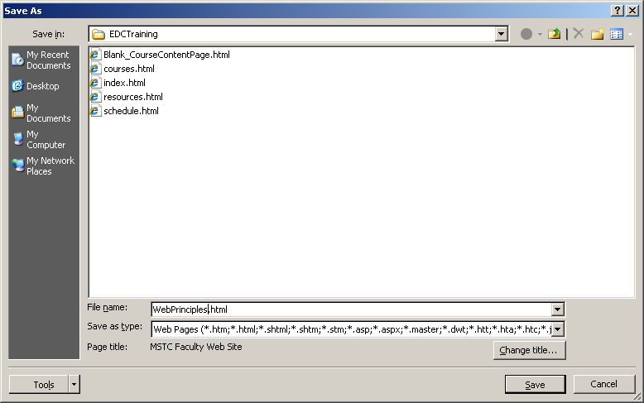
Creating Course Web Pages
Change the File Name to one that explains the content of this course web page.
For example “WebPrinciples.html”, then click Save.
Avoid using spaces or symbols in your file names!!!
Now edit the content of the web page as needed.

Slide 48
Additional How-To Directions
Expression Web Toolbars Explained
Add a Hyperlink
Apply the available CSS Styles
Setting Picture Properties

Slide 49
Expression Web Toolbars Explained
Menu Bar
Toolbar Options
New Document
New Site
Open Site
Save
Save All
Display in Super Preview
Preview in Internet Explorer

Slide 50
Expression Web Toolbars Explained
Style Font Font Size
Undo
Redo
Bold
Italic
Underline
Align Text Left
Center
Align Text Right
Numbering
Bullets
Decrease Indent Position
Increase Indent Position

Slide 51
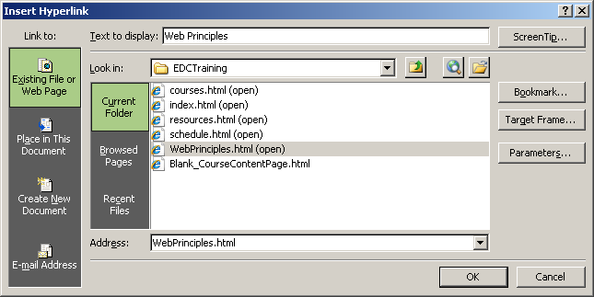
Create a New Hyperlink
Select Text to be hyperlinked
Right click
Select Hyperlink
Select the file or type in the web Address
The “Text to display” will be automatically filled in with the highlighted text
Click OK

Slide 52
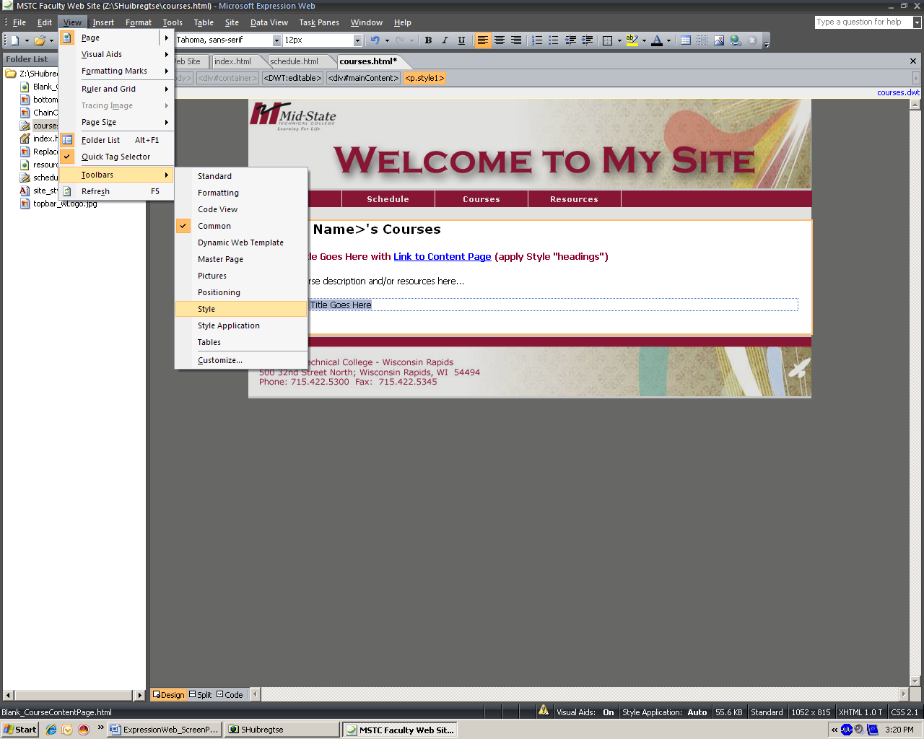
Apply Available CSS Styles
To display the Style Toolbar click View on the menu bar
Hover over Toolbars
Select Style

Slide 53
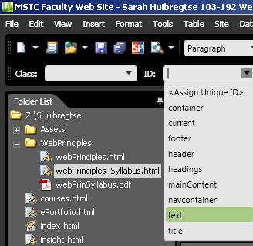
Apply Available CSS Styles
Highlight the text you would like to format
Click the ID dropdown arrow
Select one of the available Styles
The rest of the available styles are used for the template.
Please contact Sarah Huibregtse if you are interested in learning how to create your own styles.

Slide 54
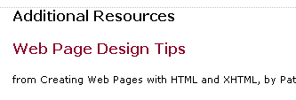
Apply Available CSS Styles
The available Styles appear as follows
The title style makes text appear like “Additional Resources”
The headings style makes the text appear like “Web Page Design Tips”
The text style makes the text appear like “from Creating Web Pages…”

Slide 55
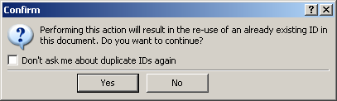
Apply Available CSS Styles
If you apply the same style multiple times on your web page you will receive the following message
Check the box if you wish to not receive the warning message again
Click Yes to apply the style

Slide 56
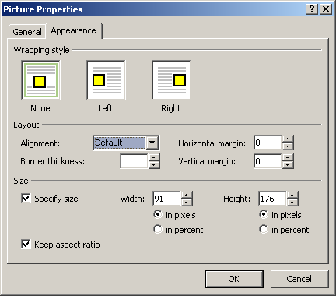
Setting Picture Properties
Wrapping Style
Sets how the text will flow around the image
Layout Options
Alignment – sets how the text will align on the side of the image
Border thickness – if you choose to have a border (zero needs to be set if you are hyper linking the image)
Horizontal margin – white space to the left and right of the image
Vertical margin – white space on the top and bottom of the image
Size
Specify size allows you to adjust the actual size of the image
Keep aspect ratio keeps the picture at the appropriate proportions as you enlarge or shrink your image
Width and Height allows you to change the size of your image by pixels or percent

Slide 57
Experiment As You Setup Your Pages

Slide 58
SAVE, SAVE, SAVE!!!
The asterisk lets you know that you haven’t saved your web page
To save do ONE of the following
Click the Save icon
Press CTRL + the letter “S”
Click the Save All icon
Click File on the menu bar and select
Save
Save As…
or Save All

Slide 59
Experiment As You Setup Your Pages
Expression Web 3 is in the process of being deployed. Please be patient!
It is available in the EDC and room A235.

Slide 60
Additional Expression Web Resources
Expression Web Tutorials and Templates
http://www.expression-web-tutorials.com/
Any Expression Design
http://any-expression.com/
Microsoft Expression: Learn Expression Web
http://expression.microsoft.com/en-us/cc197140.aspx

Slide 61
My Contact Information
Sarah Huibregtse
Instructional Technology Coordinator
Phone: 715.422.5463
Email: sarah.huibregtse@mstc.edu
Office: L131
Wisconsin Rapids Employee Development Center
Room L130

